Slide 1




DEEPSEEK R1
RL STRIKES BACK
PRESENTED BY MIKE DOAN

Slide 2

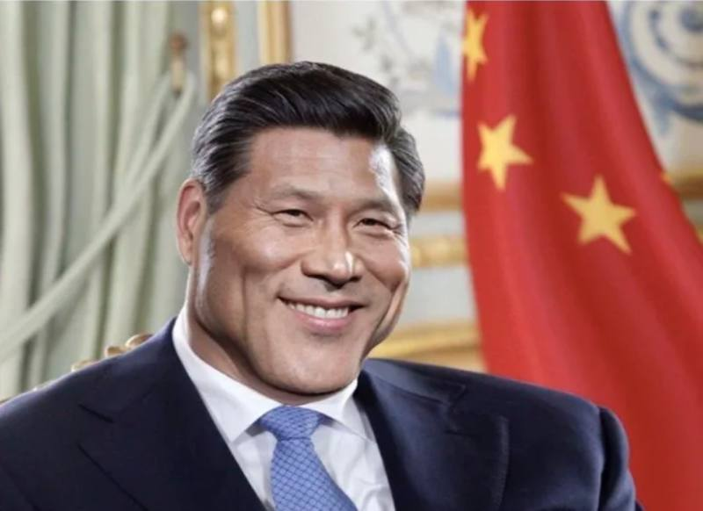
̶ ̶W̶H̶O̶ ̶I̶S̶ ̶D̶E̶E̶P̶S̶E̶E̶K̶ ̶ ̶
WHAT IS MATH? WHAT IS REASONING?
RL, A BRIEF HISTORY
DEEPSEEK R1
GRPO AND REASONING DISTILLATION
RESULTS

Slide 3

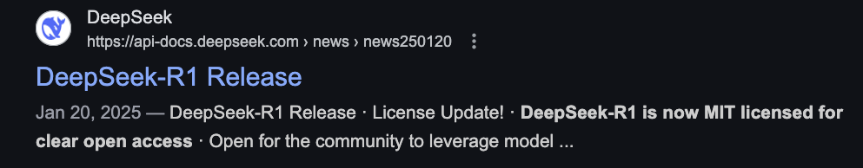
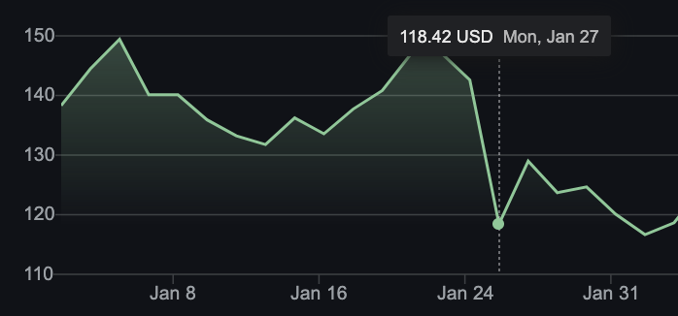
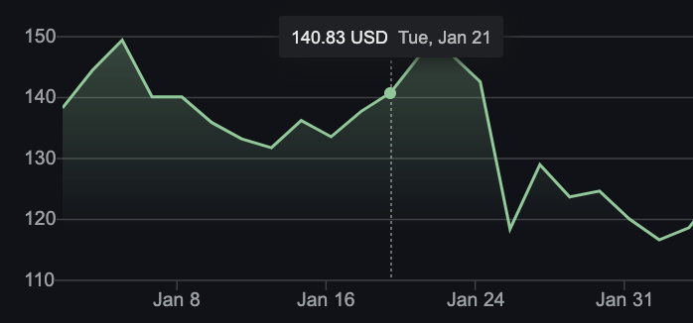
CHAPTER I - WHO IS DEEPSEEK
Notes:
find

Slide 4
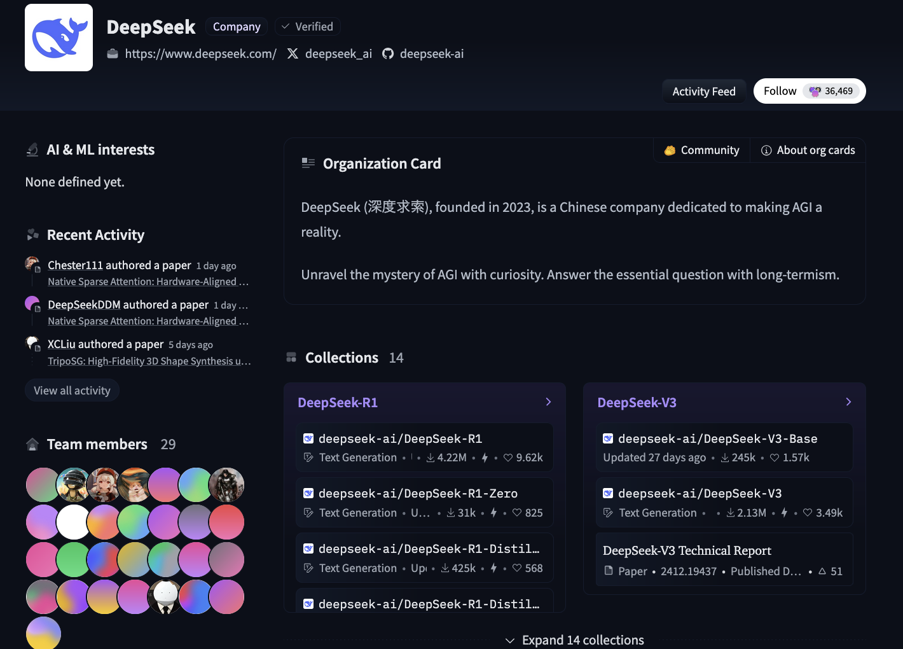
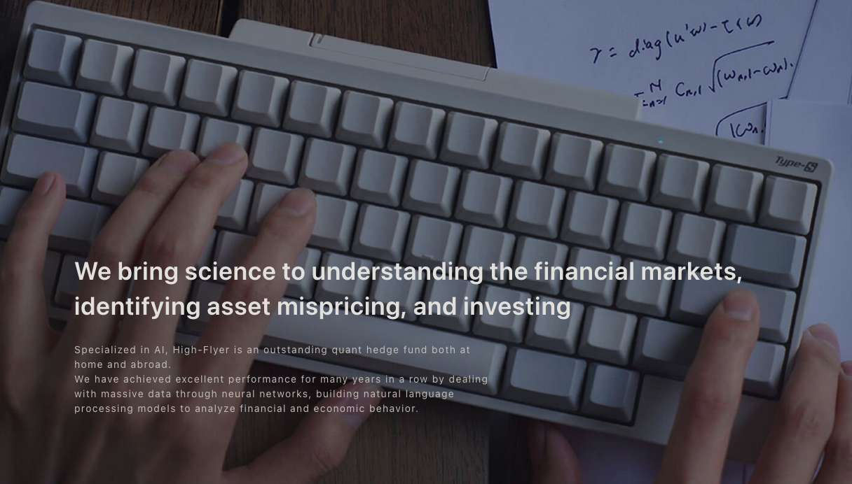
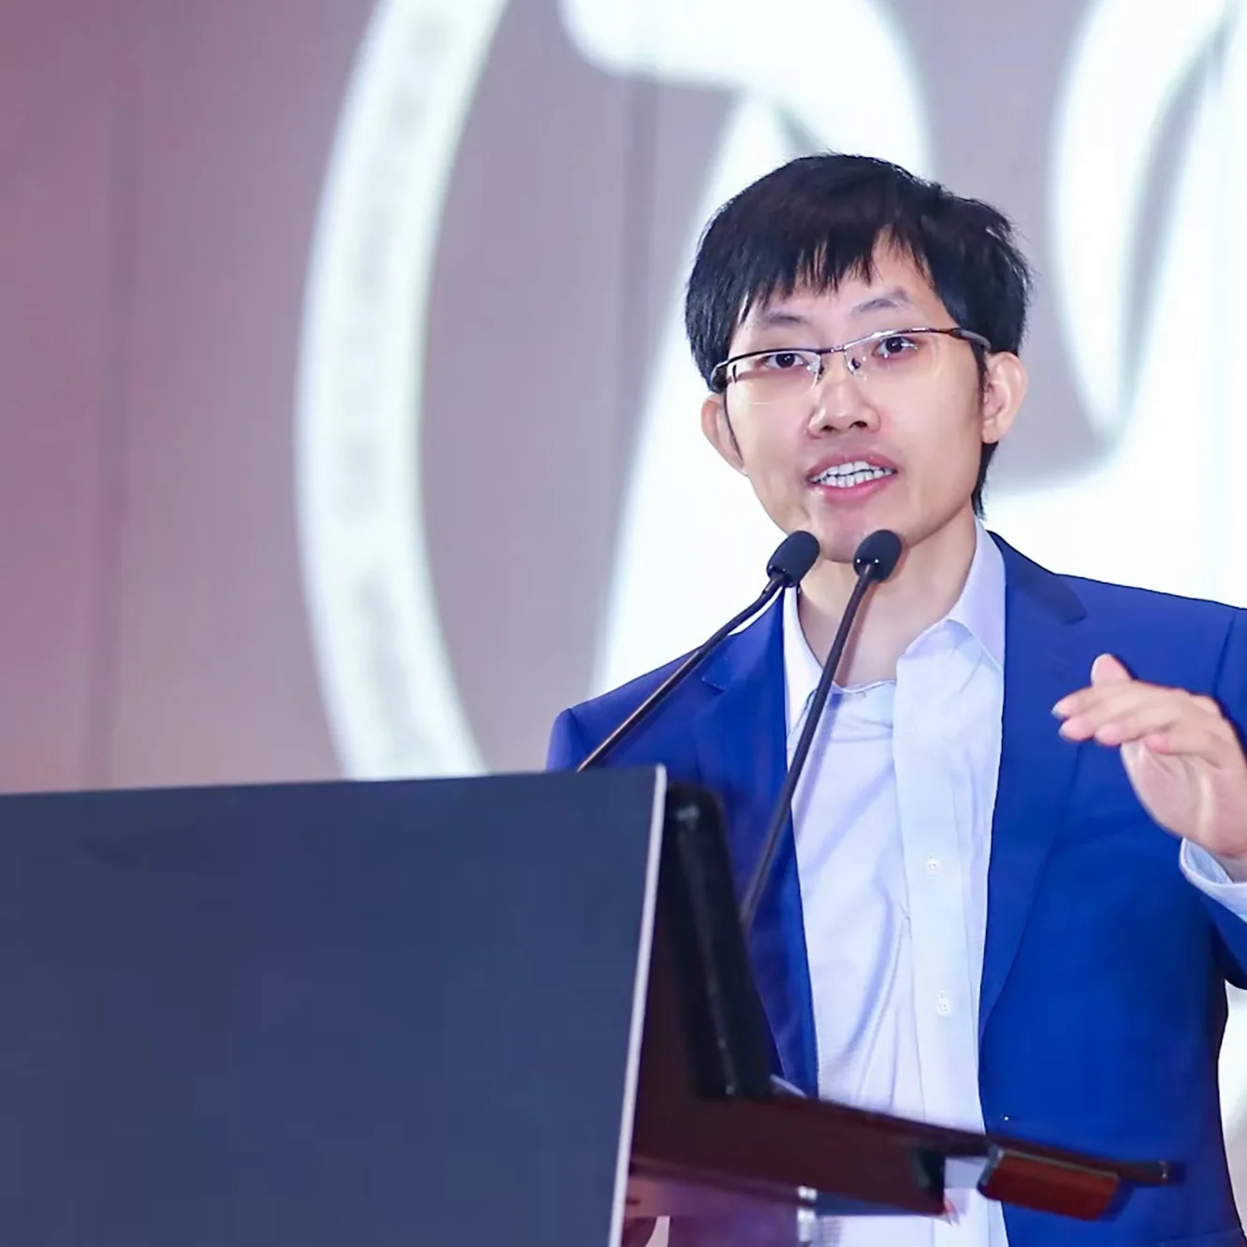
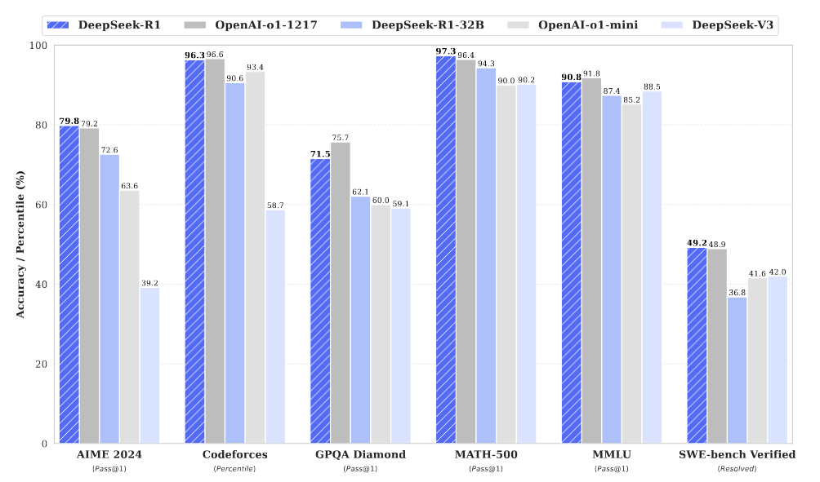
WHO IS DEEPSEEK
1.Liang Wenfeng is CEO of:
2.HighFlyer which owns:
3.DeepseekAI which made:
4.Deepseek {models}, which are better / cheaper than:
5.Basically every open and closed source model available (given that they don’t get ddos’ed again)

Slide 5
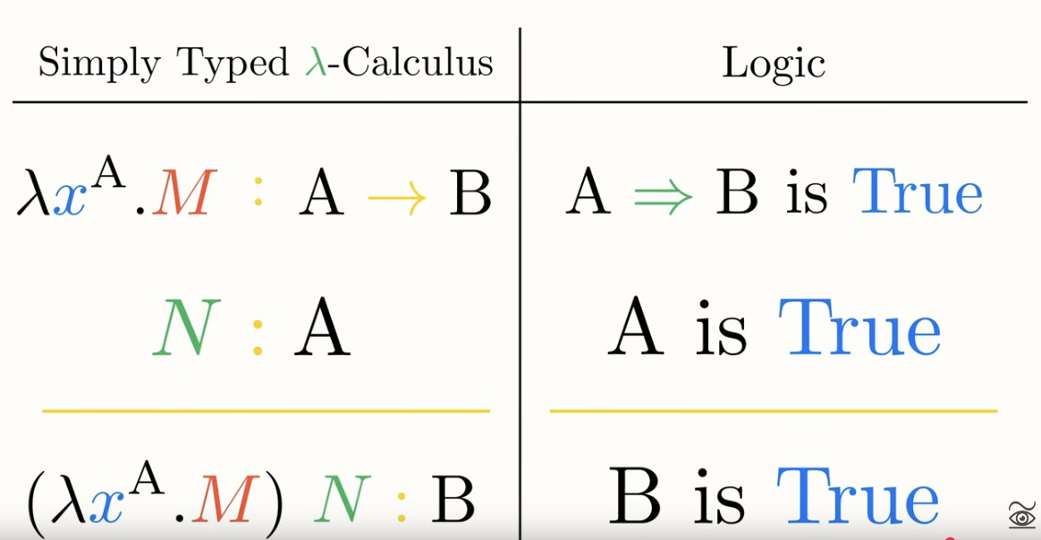
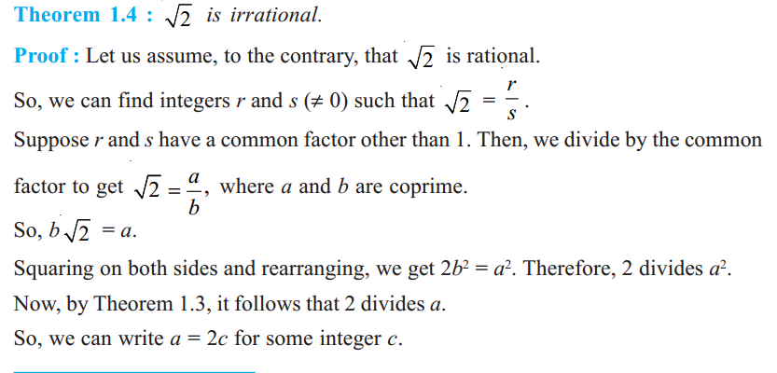
WHAT IS MATH (totally different thing from programming)

Slide 6
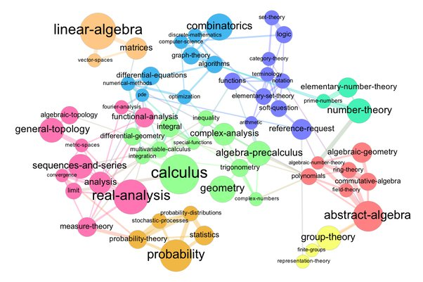
WHAT IS MATH (totally different thing from programming)

Slide 7
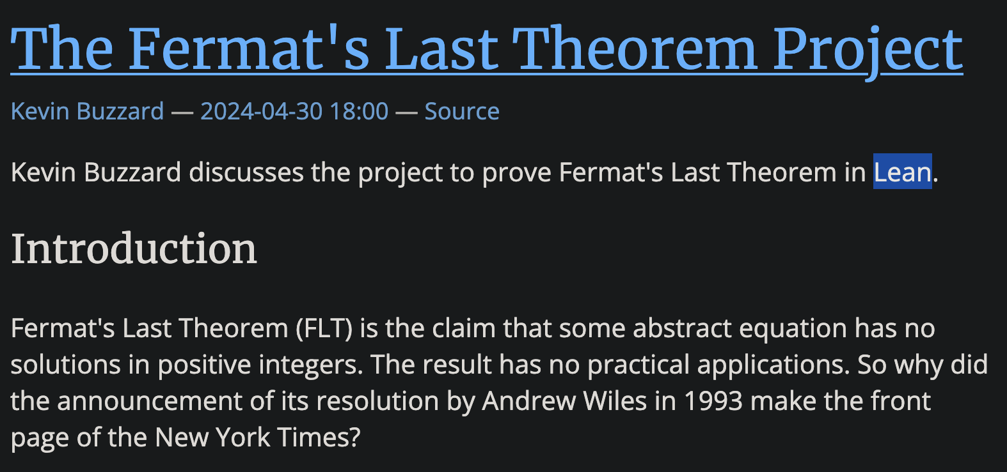
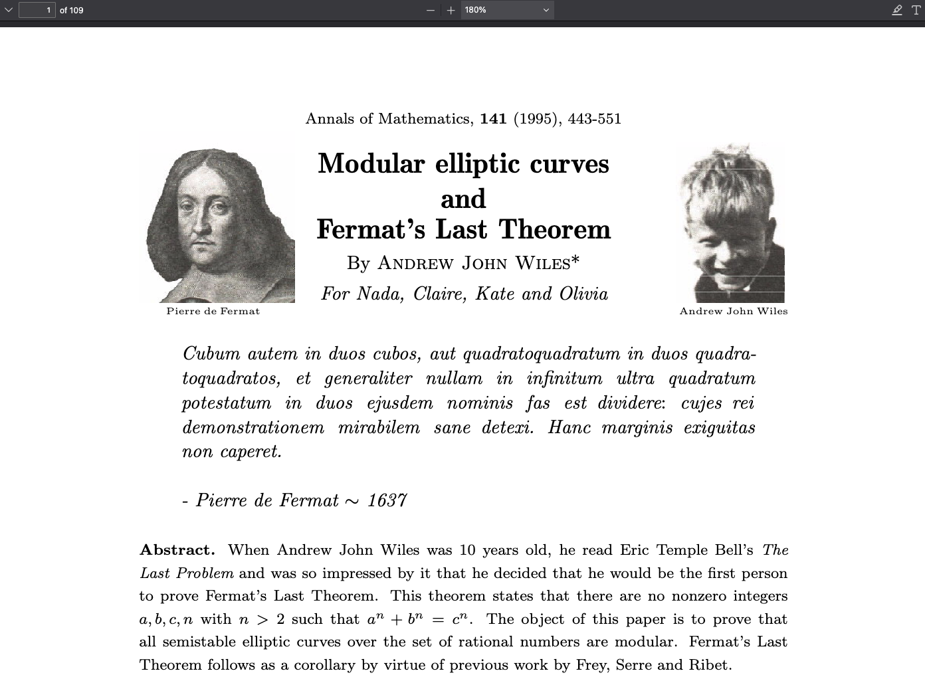
WHAT IS MATH (totally different thing from programming)

Slide 8
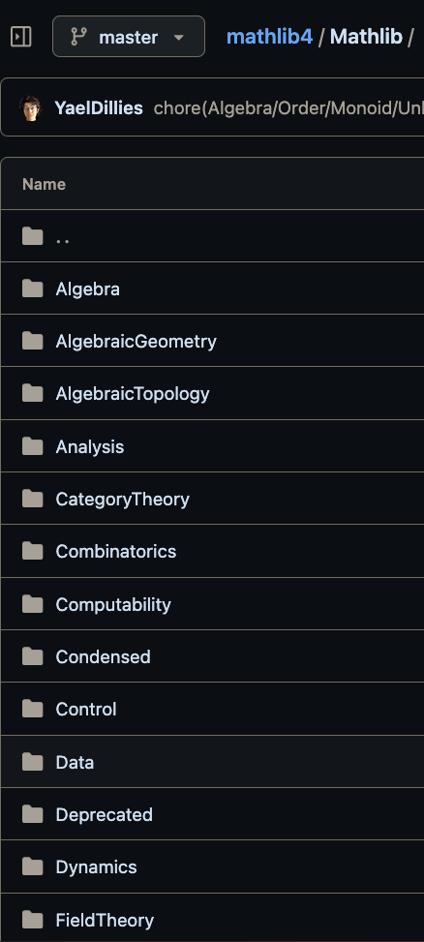
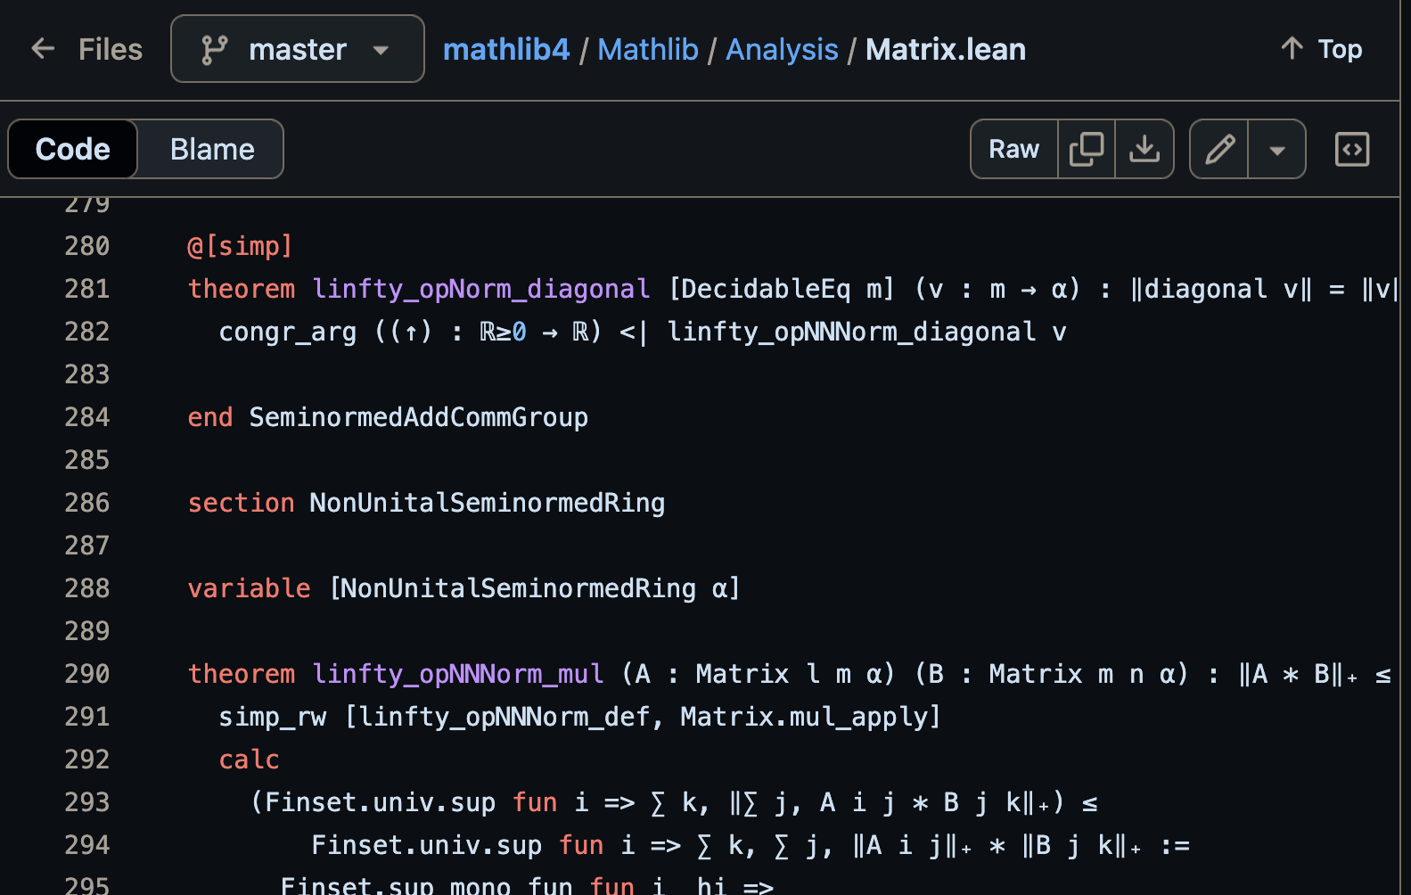
WHAT IS MATH (totally different thing from programming)

Slide 9
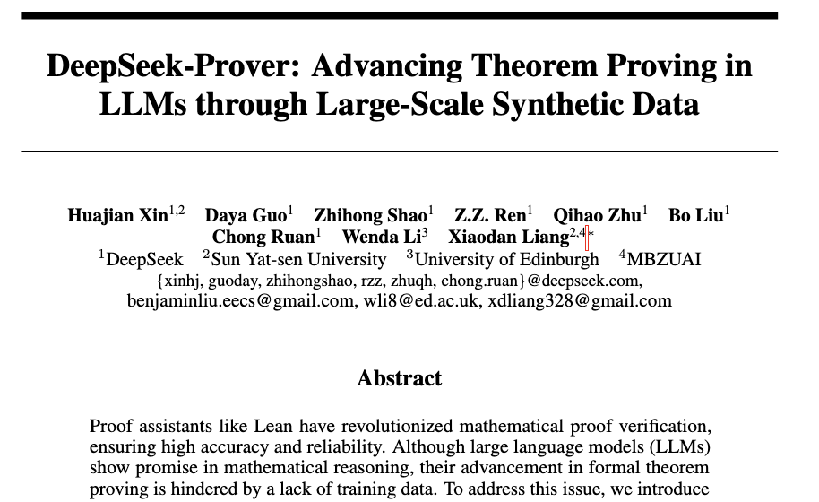
WHAT IS MATH (totally different thing from programming)

Slide 10
WHAT IS REASONING

Slide 11
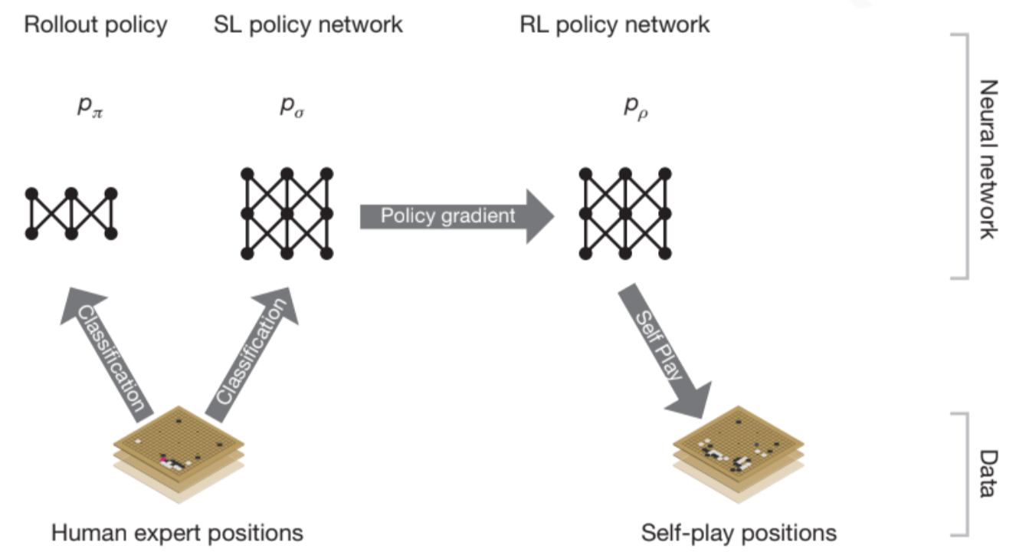
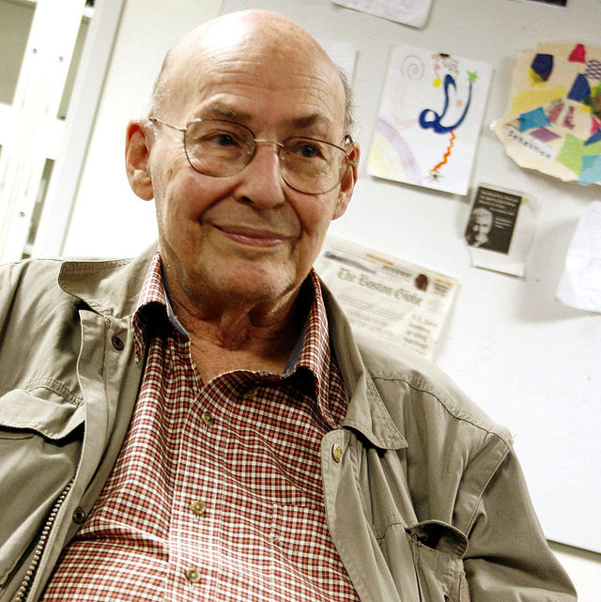
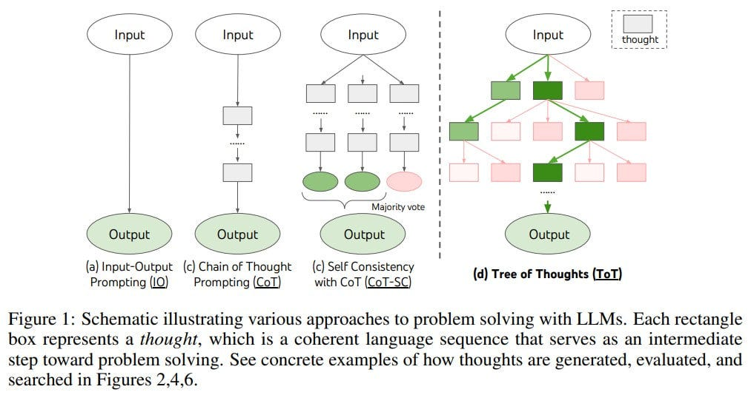

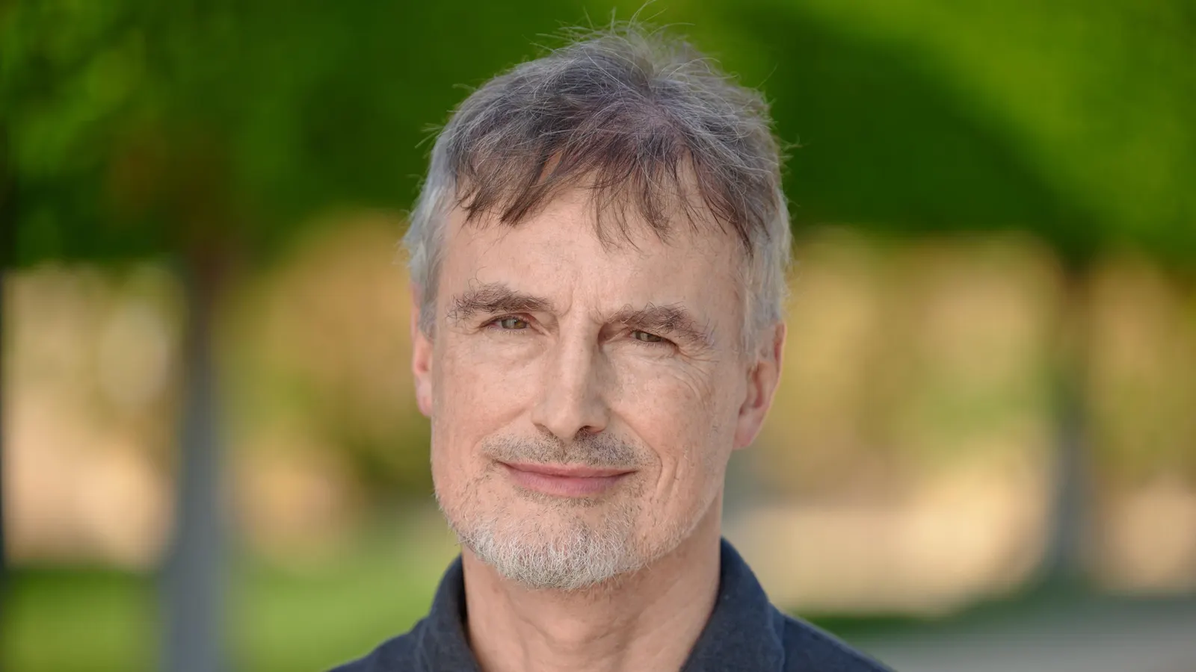
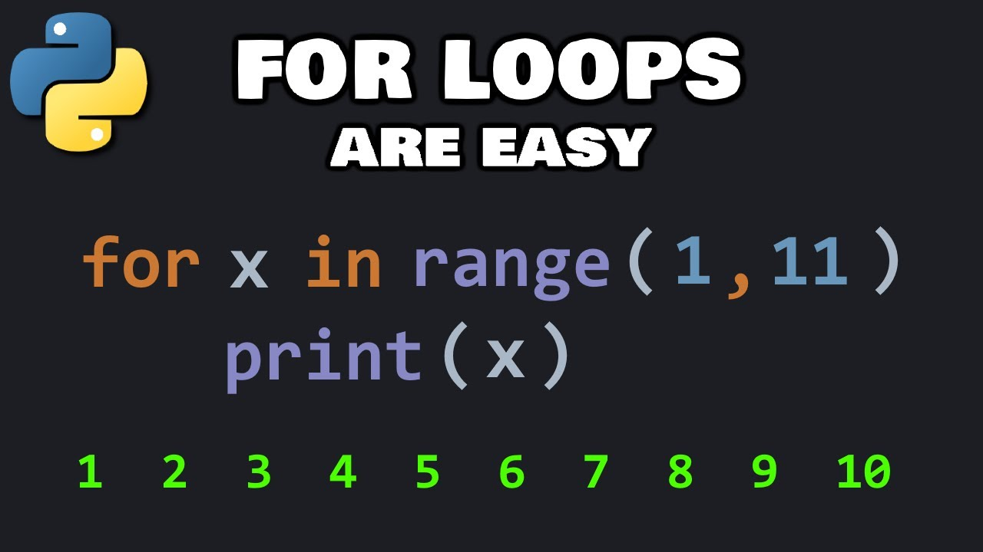
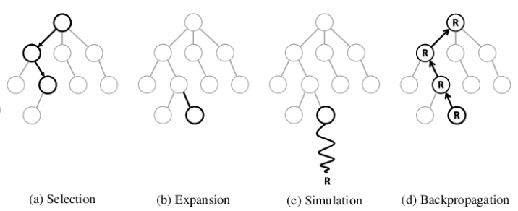
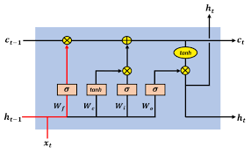

WHAT IS REASONING
REASONING IS WHEN TREES AND LOOPS ACTUALLY

Slide 12
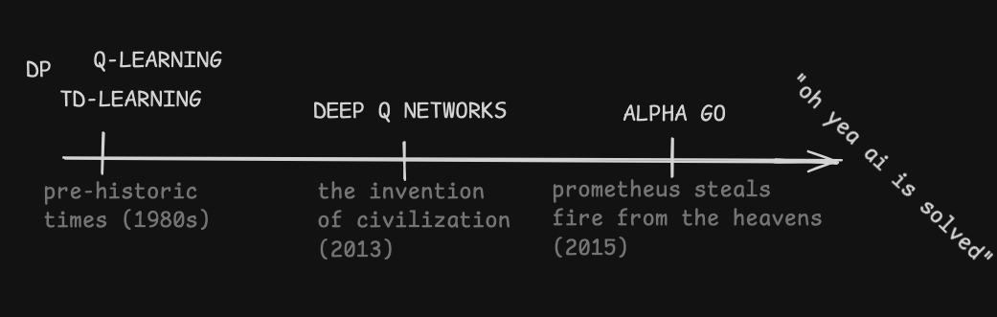
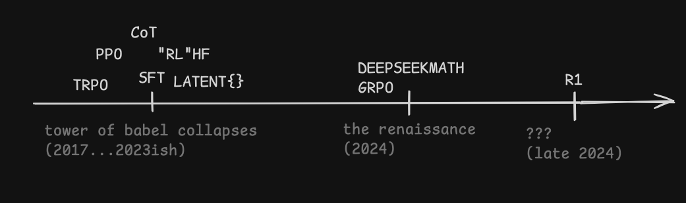
RL, A BRIEF HISTORY

Slide 13
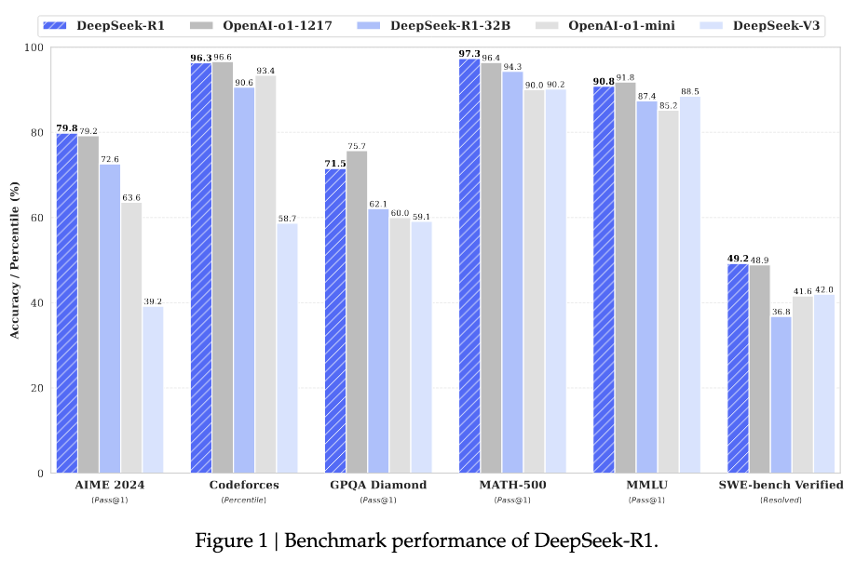

DEEPSEEK R1

Slide 14
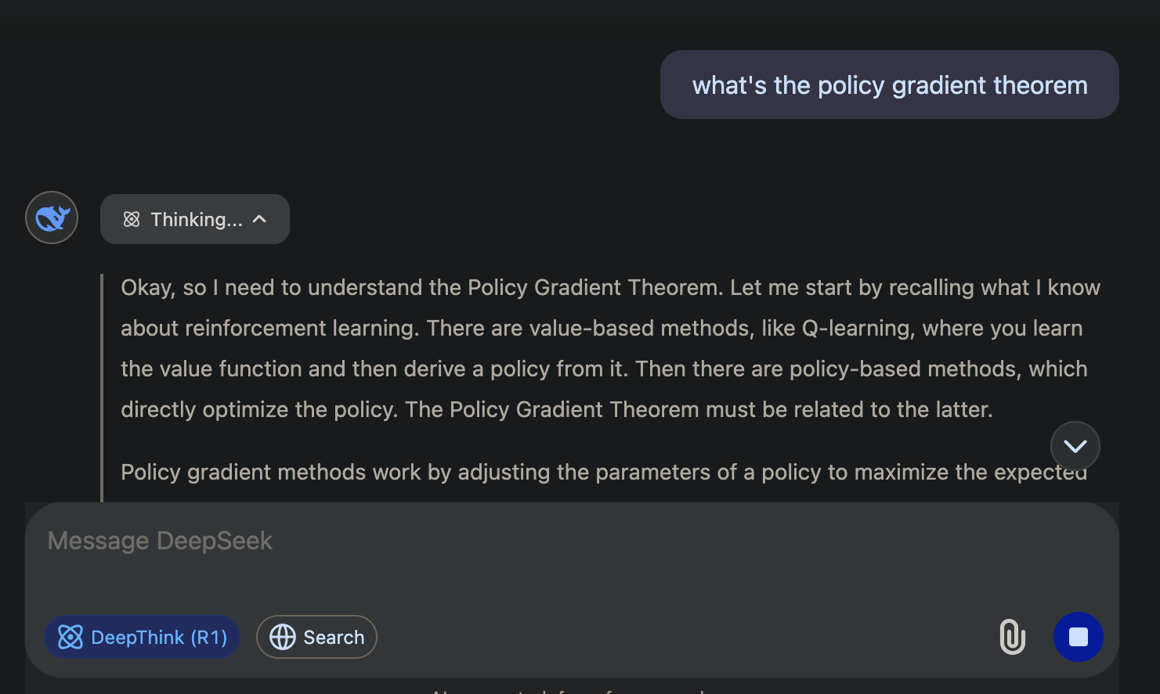
TRY DEEPSEEK R1 TODAY!!!

Slide 15

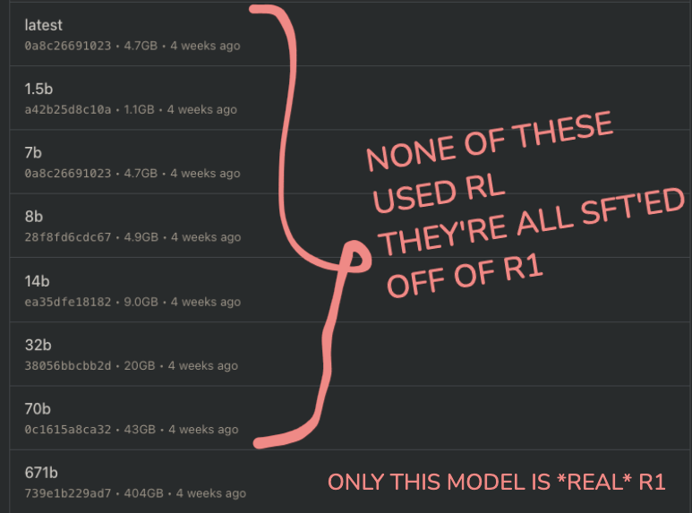

GET DEEPSEEK R1 TODAY!
brew install blob-of-software-that-totally-isn’t-malware
totally-not-just-a-llama.cpp-wrapper
ollama

Slide 16
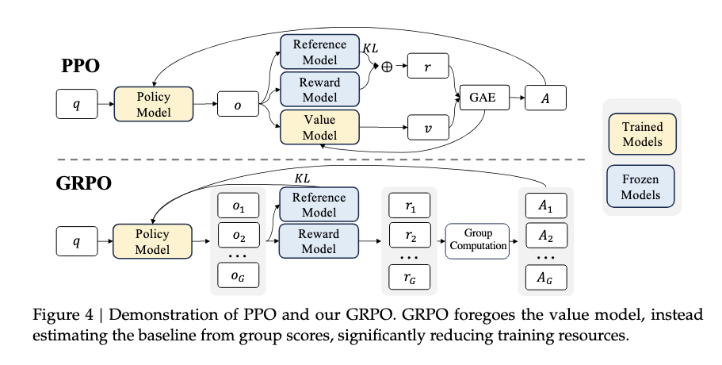
GROUP RELATIVE POLICY OPTIMIZATION (GRPO)

Slide 17
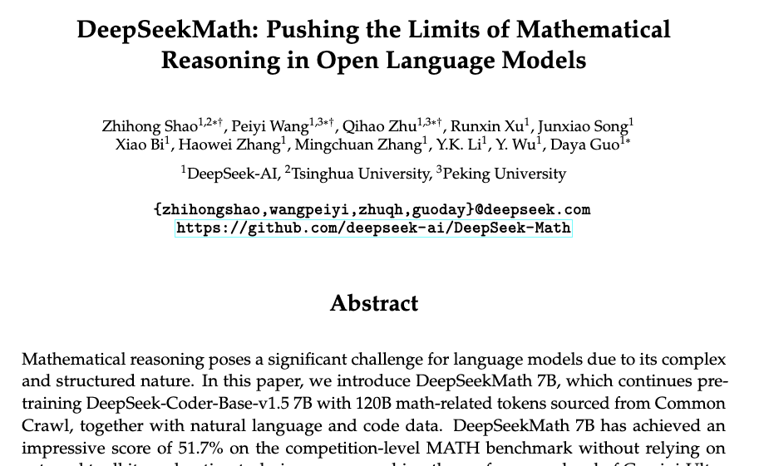
PPO TO GRPO

Slide 18
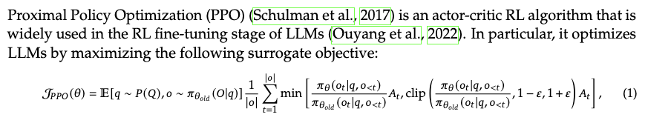
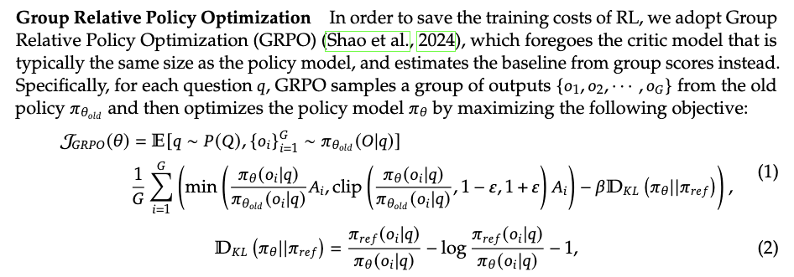
PPO TO GRPO

Slide 19
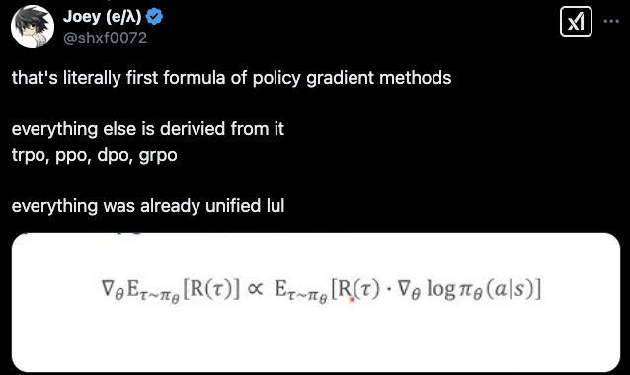
GROUP RELATIVE POLICY OPTIMIZATION (GRPO)
“The improvement in the expected reward from tweaking the model’s parameters comes from adding up the rewards you’d expect from all possible actions, adjusted by how much those tweaks shift the likelihood of choosing each action.”

Slide 20
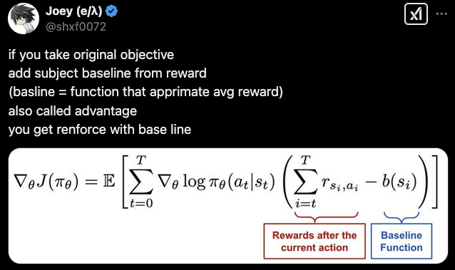
GROUP RELATIVE POLICY OPTIMIZATION (GRPO)

Slide 21
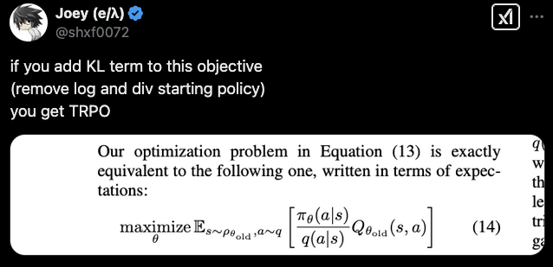
GROUP RELATIVE POLICY OPTIMIZATION (GRPO)

Slide 22
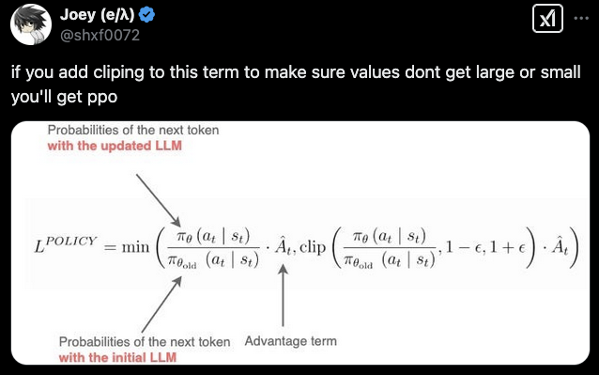
GROUP RELATIVE POLICY OPTIMIZATION (GRPO)

Slide 23
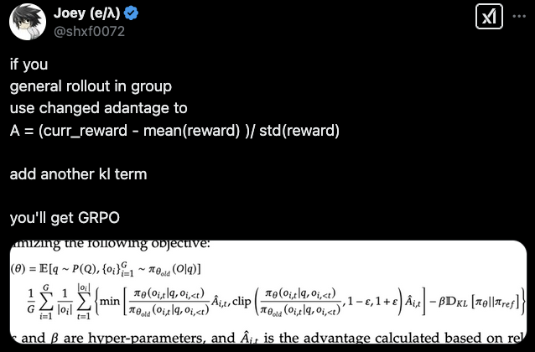
GROUP RELATIVE POLICY OPTIMIZATION (GRPO)

Slide 24
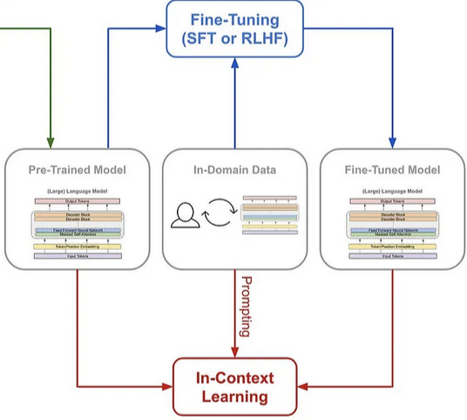

SUPERVISED FINE TUNING (SFT)
LLAMA
QWEN OPENAI
DEEPSEEK

Slide 25
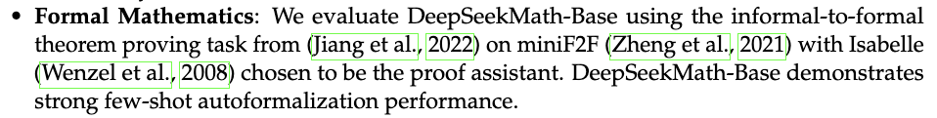
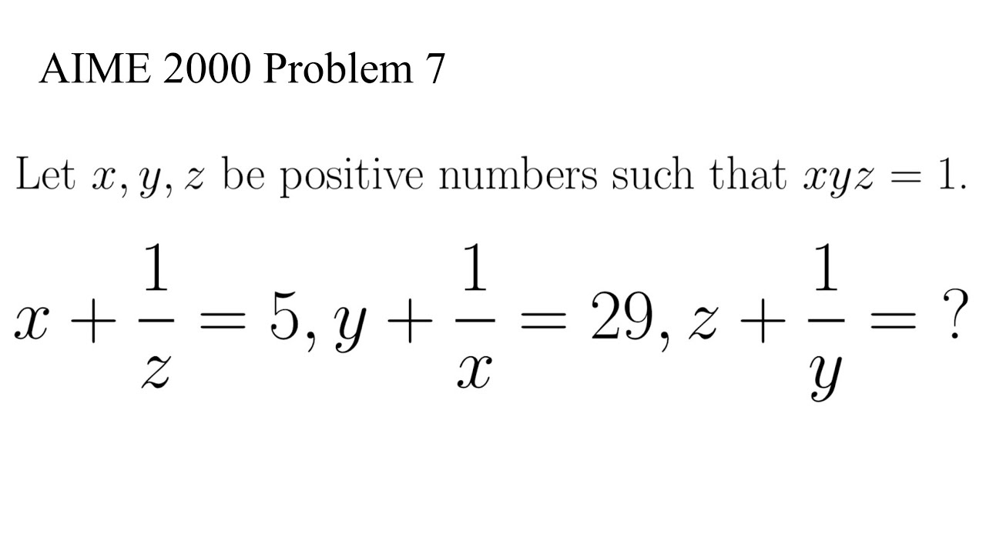
FORMAL VERIFICATION
LLAMA
QWEN OPENAI
DEEPSEEK

Slide 26
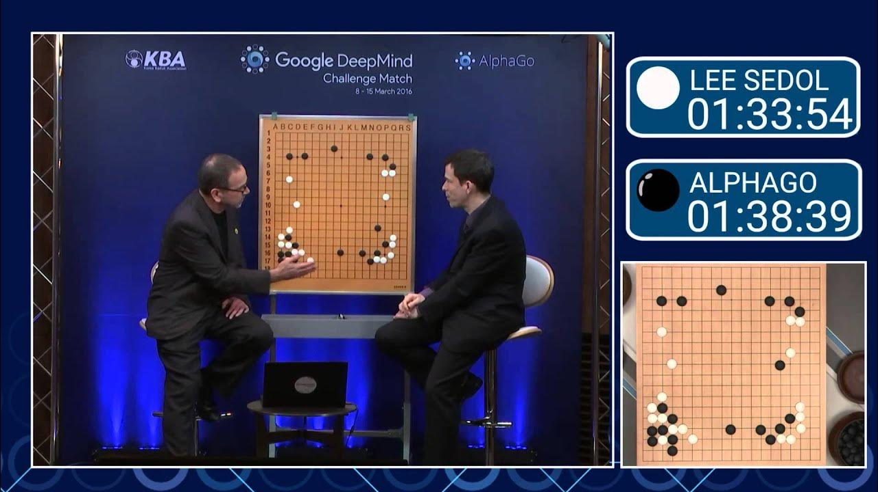
MU, ALPHA, ZERO, GO!

Slide 27
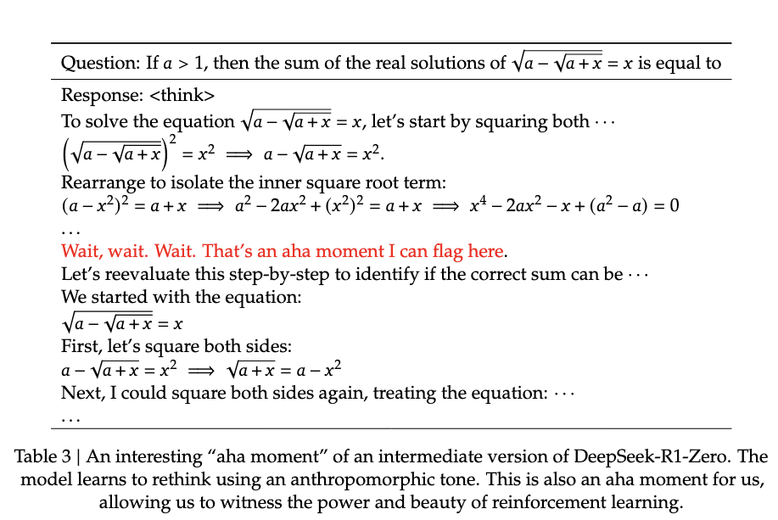
MOVE 37 OF LLMS

Slide 28

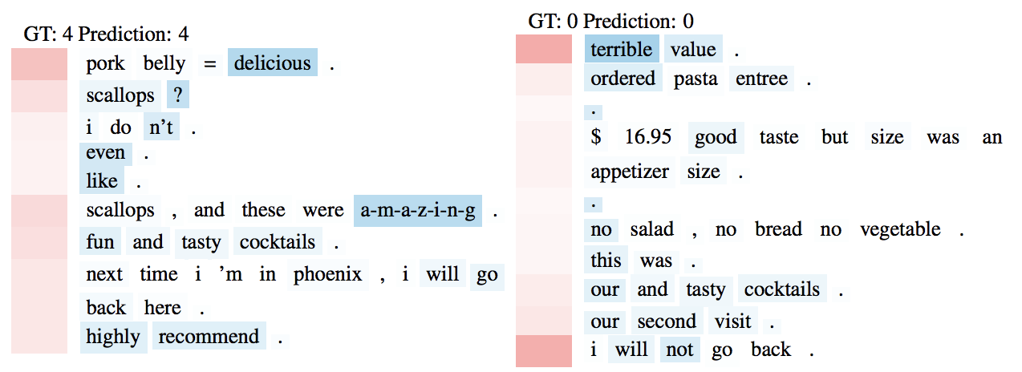

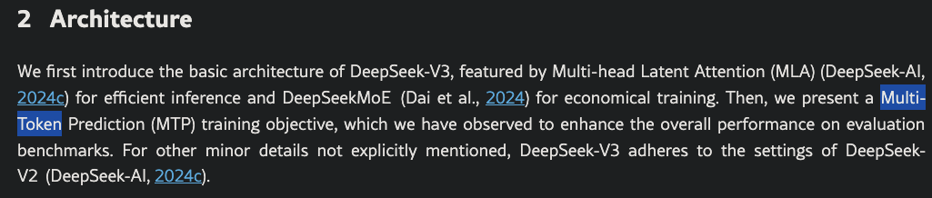
HOT TAKE: LLMS AREN'T “NEXT TOKEN PREDICTORS”

Slide 29
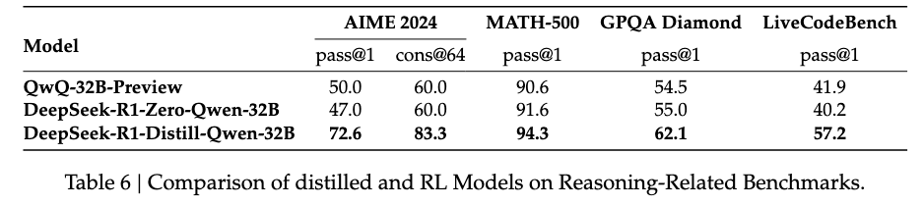
TRAINING PROCEDURE
Train deepseek v3
Demolish the US stock market
Train v3 using GRPO -> R1 Zero
Tune R1 zero for human preference and downstream task -> R1
Use outputs of R1, fine tune various small models -> R1 {qwen|llama|...} small models
Very important: small models get better **evals** than models trained with RL, but it’s unclear if they’re smarter

Slide 30
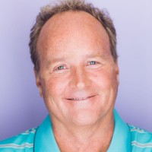
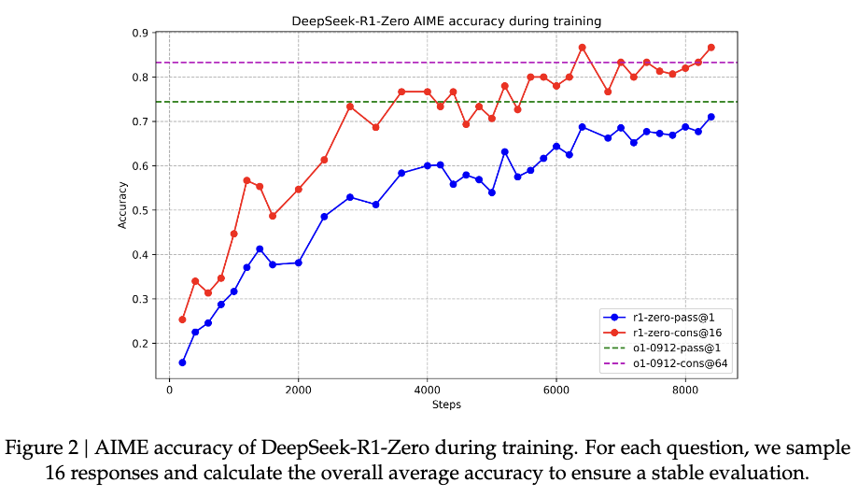
BITTER LESSON
Don’t really know what to put here so here’s a cursed rare picture of unshaved Rich Sutton

Slide 31
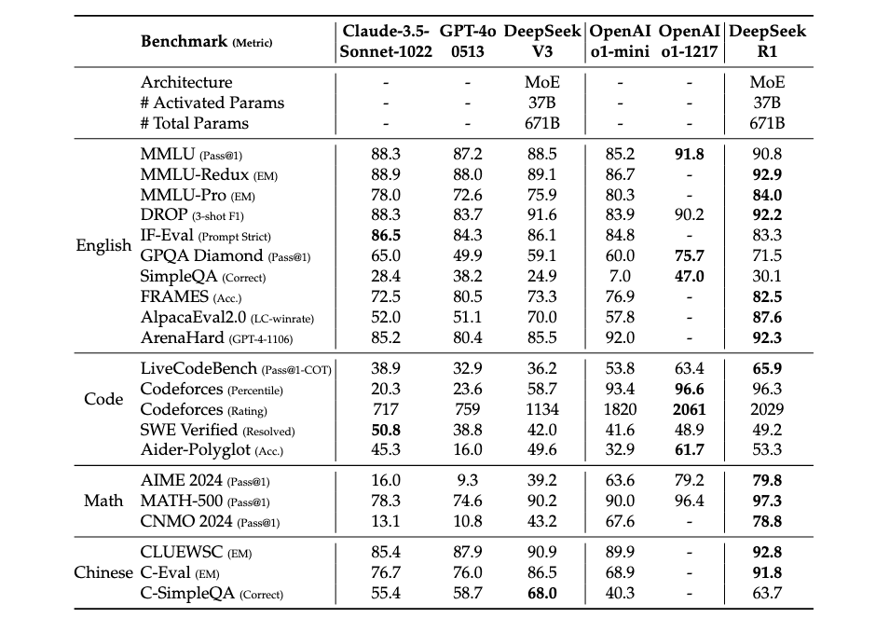
EVALUATION

Slide 32
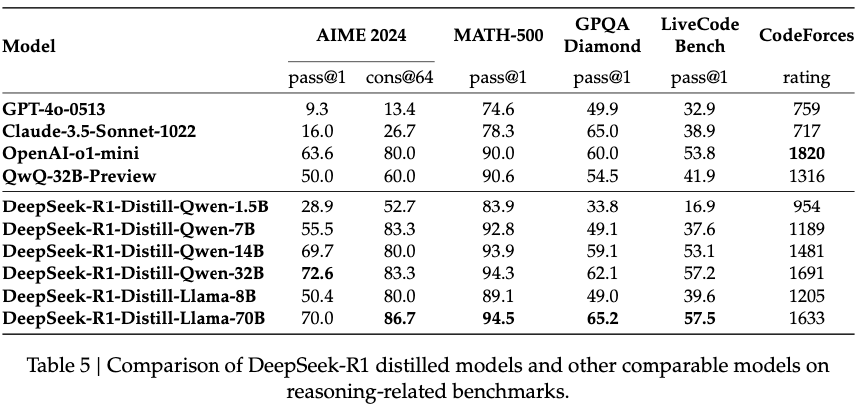
REASONING BY PROXY

Slide 33
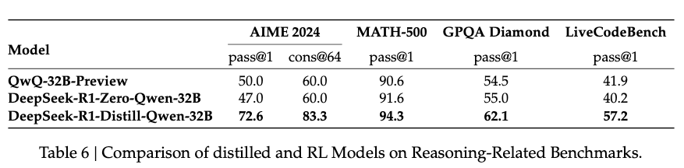

… WHICH IS SOMEHOW BETTER THAN REASONING

Slide 34




SO HOW MANY S-CURVES DOES THAT MAKE?

Slide 35



BONUS CURVES: ACTUAL HARD WALLS

Slide 36


EXTRA: THINGS THAT DIDN’T WORK

Slide 37
QUESTIONS

